Slide 1
Handwritten Digit Recognition System
Presented by:
Mohan Acharya (1NT22CS116)
Pradeep Badu (1NT22CS133)
Prince Chaudhary (1NT22CS143)
Rahul M (1NT23CS409)

Slide 2
Introduction
The Python script used for building the application “Handwritten digit recognition” builds a Convolutional Neural Network (CNN) to recognize handwritten digits using the MNIST dataset, then sets up a Graphical User Interface (GUI) where a user can draw a digit and get it classified.

Slide 3
Importing Required Libraries
The script imports necessary libraries like Keras, NumPy, and Tkinter (for the GUI).
keras.datasets.mnist: Loads the MNIST dataset.
Sequential, Conv2D, MaxPooling2D, etc.: Helps in defining and training a CNN model.
ImageGrab: Captures the drawing from the GUI to process it for prediction.

Slide 4
Loading and Preprocessing the Dataset
MNIST Dataset contains images of handwritten digits (0-9) and 60,000 training images, 10,000 test images.
The data is split into training and testing sets.
Images are reshaped to 28x28x1 (since MNIST images are grayscale).
Labels (digit classes) are one-hot encoded for classification.
Pixel values are normalized to a range of 0-1 to improve model performance.

Slide 5
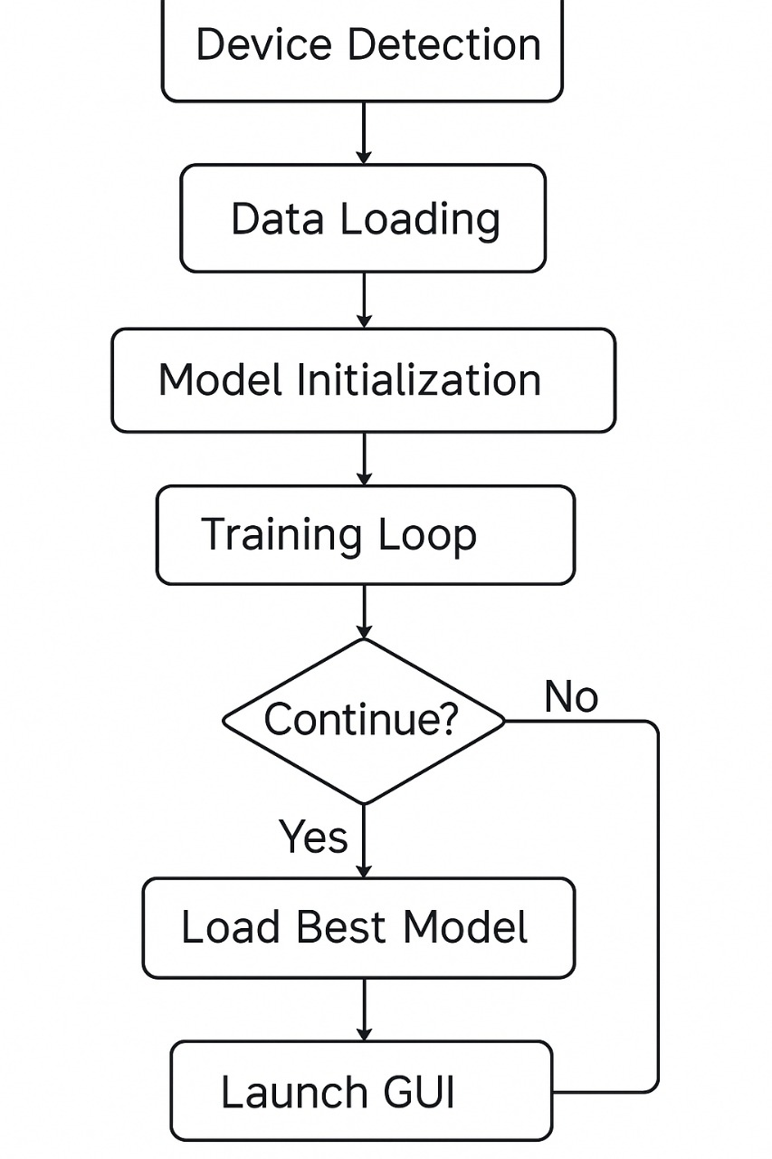
flow of Model

Slide 6
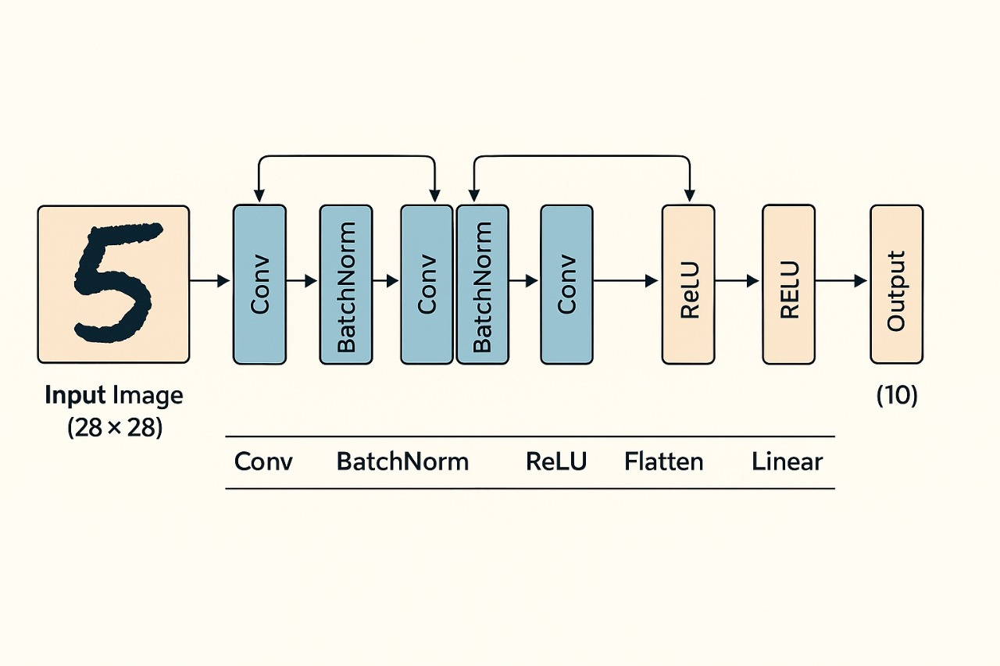
Working of CNN(Convolutional Neural network)

Slide 7
CNN Architecture for MNIST Digit Classification
1. Input Layer
Size: 28×28 pixels
Type: Grayscale handwritten digit
2. Feature Extraction
Two Convolutional Layers (Conv → BatchNorm → ReLU ×2)
Extracts features like edges and curves
Batch Normalization stabilizes activations
ReLU introduces non-linearity
3. Dimensionality Reduction
Max Pooling (Reduces spatial size while retaining key features)
4. Flattening
Converts 3D feature maps into a 1D vector (e.g., [64×12×12] → [9216])
5. Fully Connected Layers
Dense Layer 1 (128 neurons + Dropout for regularization)
ReLU Activation
Dense Layer 2 (10 neurons → One for each digit 0–9)
6. Output
Predicts the digit with the highest confidence score

Slide 8
Building the CNN Model
A Sequential model is created layer by layer.
Convolution Layers (Conv2D): Extracts features like edges, curves, etc.
MaxPooling Layer (MaxPooling2D): Reduces computational complexity.
Dropout Layers (Dropout): Helps prevent overfitting.
Flatten Layer (Flatten): Converts data into a 1D format for the next layers.
Dense Layers (Dense): Fully connected layers for final classification.
Softmax Activation: Ensures probabilities for the 10 digit classes.

Slide 9
Training and Saving the Model
The model is compiled using the categorical_crossentropy loss function and Adadelta optimizer.
It is trained using the MNIST dataset for 10 epochs.
The trained model is saved as mnist.h5.

Slide 10
Setting Up the GUI for Handwritten Digit Recognition
The Tkinter-based interface provides a canvas where users can draw digits.
The drawing is captured, resized, and converted into grayscale.
The trained model predicts the digit and updates the label with confidence percentage.
Buttons like "Recognize" and "Clear" allow interaction.

Slide 11
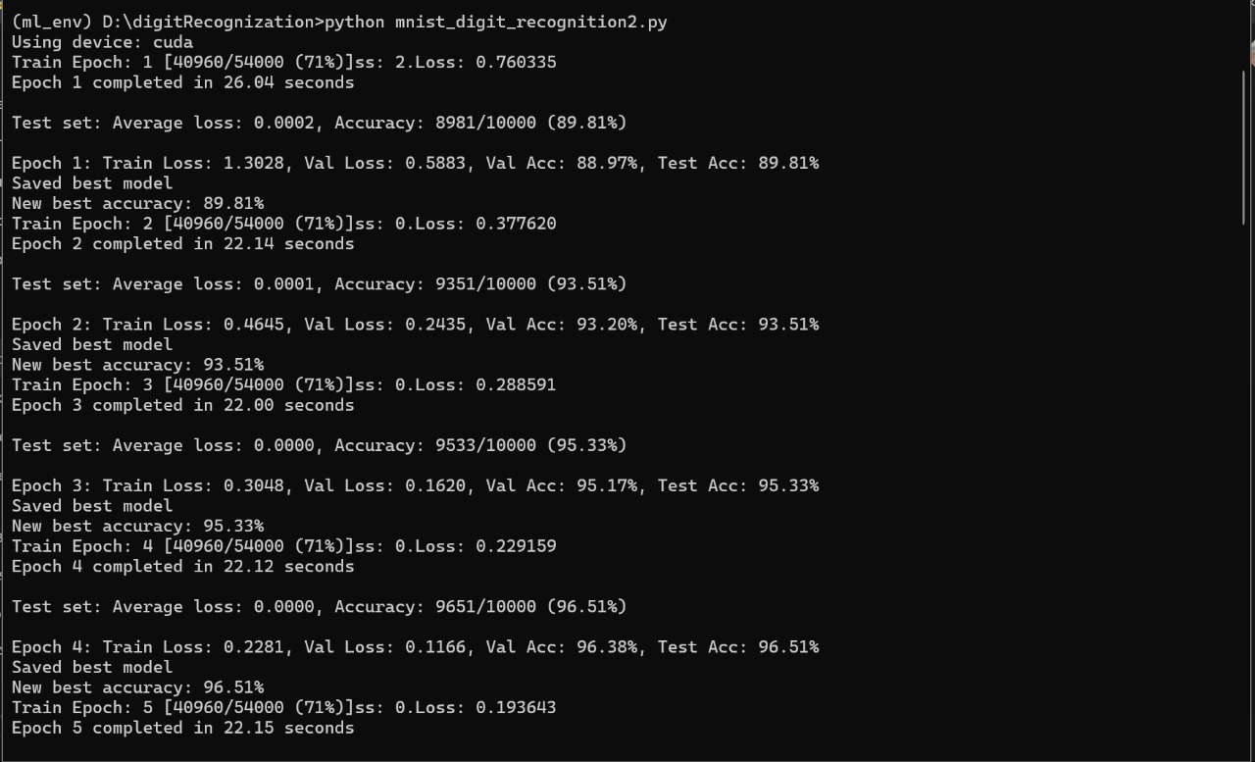
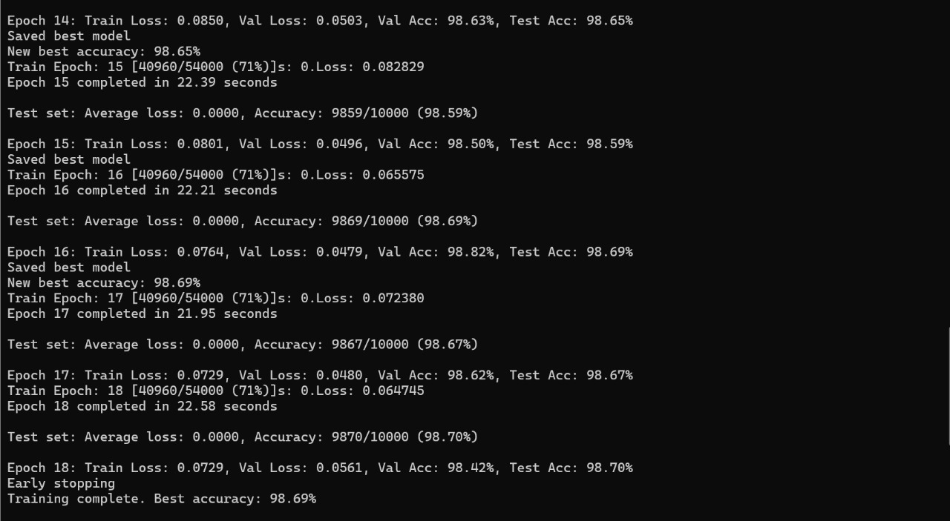
Project demonstration

Slide 12
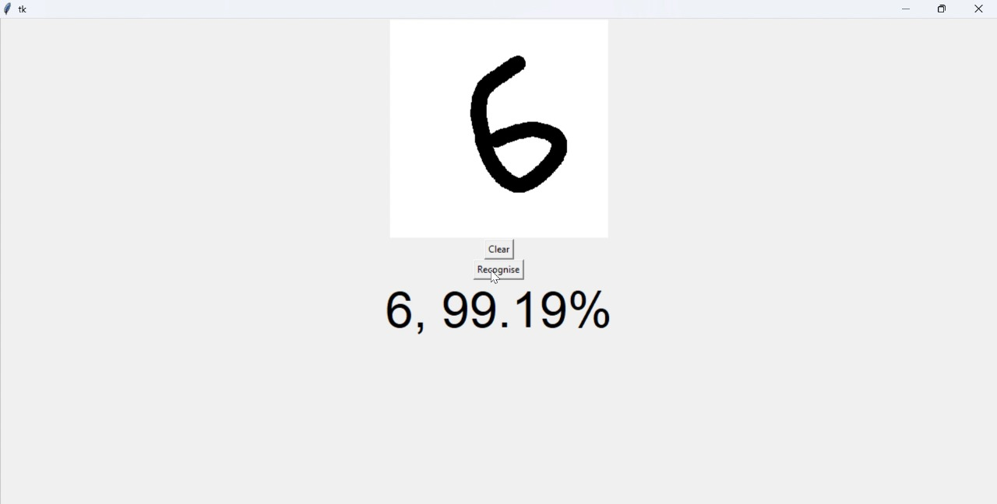

Model accuracy

Slide 13
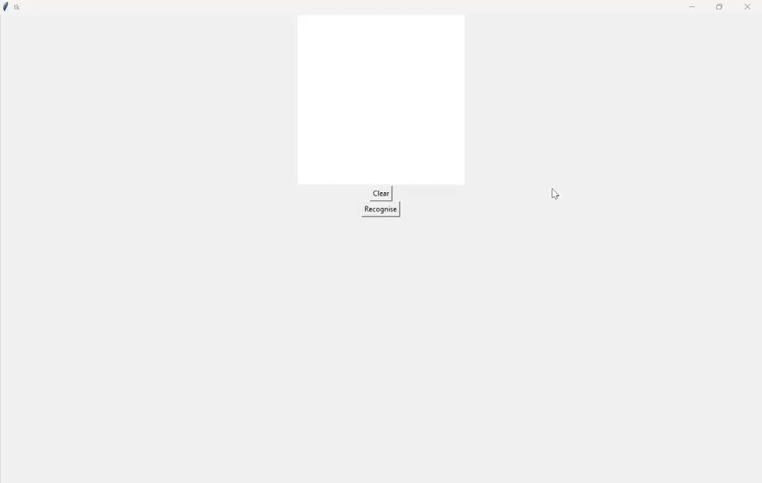
Model demo video

Slide 14
Scope & Future Enhancements
Potential Applications
✔ Banking & Financial Services
Automates handwritten form processing for digital banking.
Enhances fraud detection in financial transactions.
✔ Postal & Logistics Industry
Recognizes handwritten zip codes on mail and parcels.
Reduces human intervention in sorting and delivery systems.
✔ Security & Authentication Systems
Improves CAPTCHA-based bot detection.
Can be adapted for handwritten password recognition in secure environments.
✔ Education & Learning Platforms
Assists students in handwriting improvement.
Enables real-time feedback on handwritten assignments and tests.

Slide 15
conclusion
This script trains and deploys a CNN model for real-time handwritten digit recognition using the MNIST dataset and Tkinter GUI. It covers data preprocessing, model building, training, evaluation, and deployment—a complete pipeline for digit classification.

